Slide 1
Wine Reviews
Data 620
Group 3 • Fireflies

Slide 2
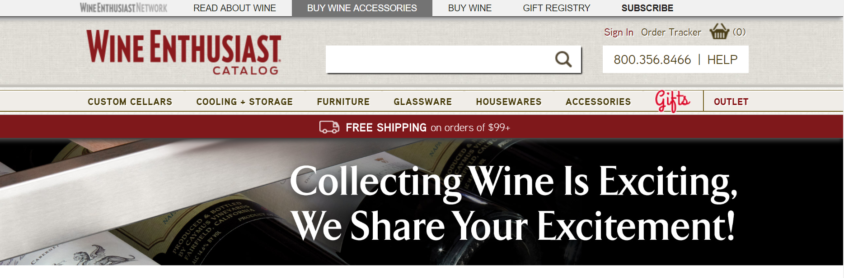
What we are going to cover?
Sentiment Analysis for Wine Reviews
Wine Vocab 101
Pick-your-wine map - Wine Recommendation in Diner
Top Wine Social Media Influencers
Find the Best Value Wines

Slide 3
Overview
Source
Wine Reviews from Wine Enthusiast as of Nov 22, 2017
Available on Kaggle (keywords: "Wine Reviews")
Data overview
37,419 reviews
446 wine varieties
16 Tasters

Slide 4
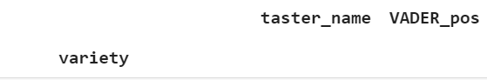
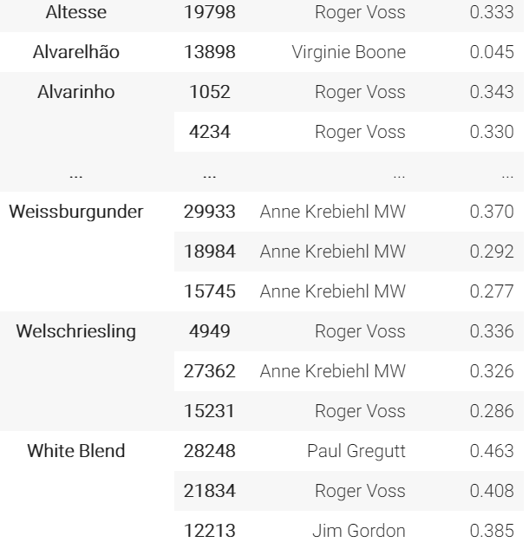
Sentiment for Reviews
Analyze tasters’ reviews by NLTK's VADER Sentimental Analyzer
VADER gives the Positive, Negative and Neutral scores to represent the proportion of text that falls in these categories. All these should add up to ONE
Question:
Whose review are top 3 for each wine by sentiment score?

Slide 5
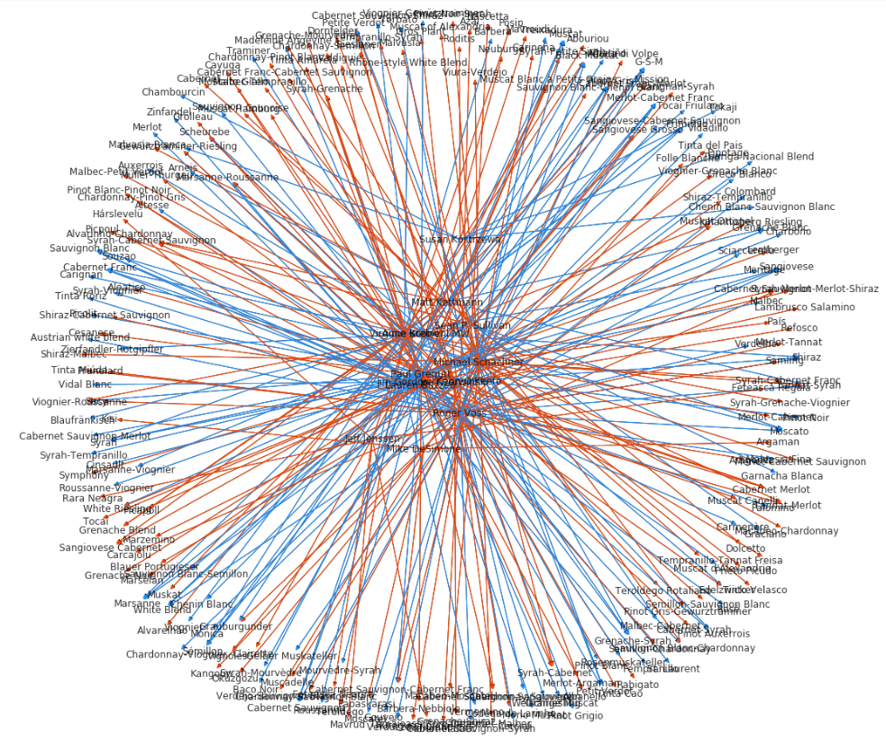
Sentiment for Tasters’ Reviews (cont.)
Taster to Wine
Blue (above Avg), Red (above Avg)

Slide 6
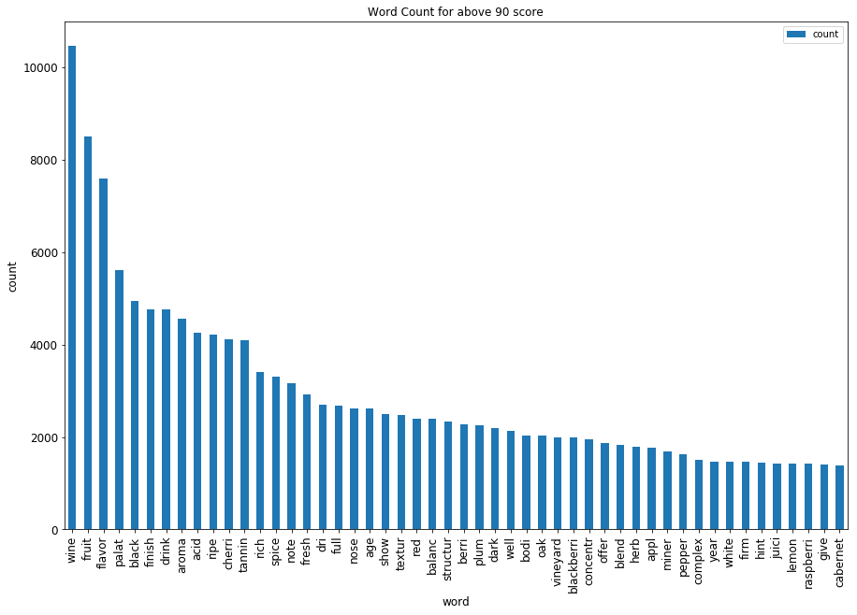
2. Sentiment Analyze:
Wine Word List
Build up sentimental keyword list for wine reviews based on score (below or above 90 points) from tasters (e.g. "Complex" is negative in English but Positive in Wine Vocab)
Example #1: Analyze social media message: is it for wine?
Example #2: Advertisement keywords for wines

Slide 7
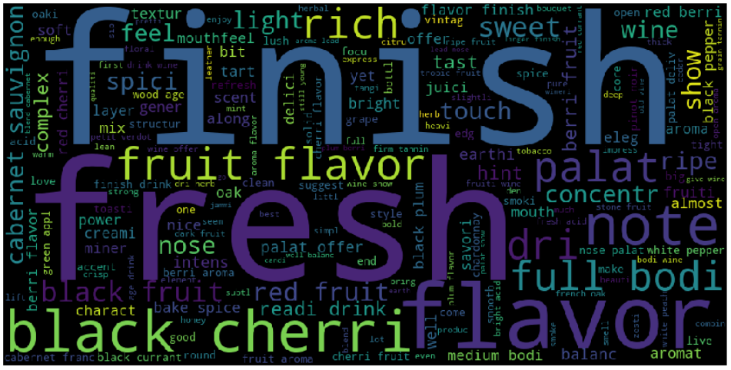
3. Wine Vocab 101
The Most Commonly used words for wine

Slide 8
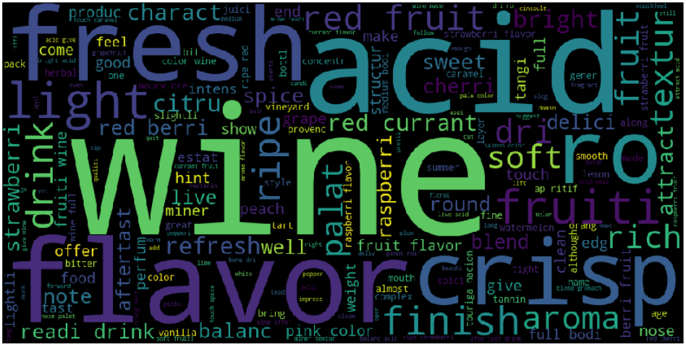
3. Wine Vocab 101 (Cont.)
Rosé-word cloud

Slide 9
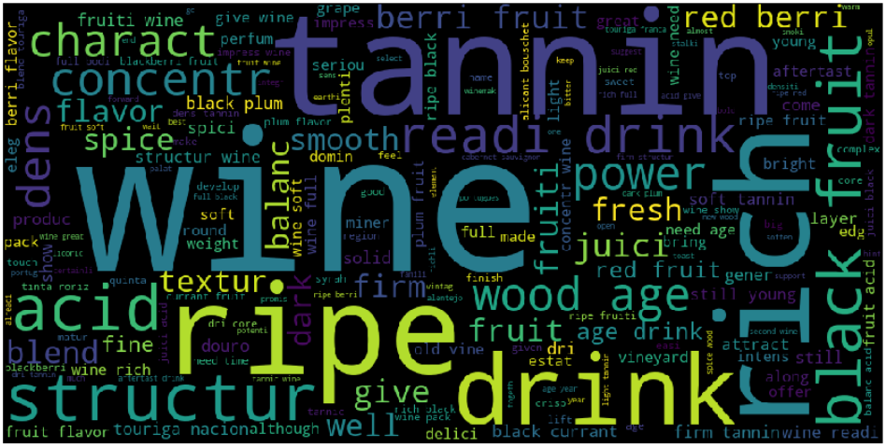
Portuguese Red -word cloud

Slide 10
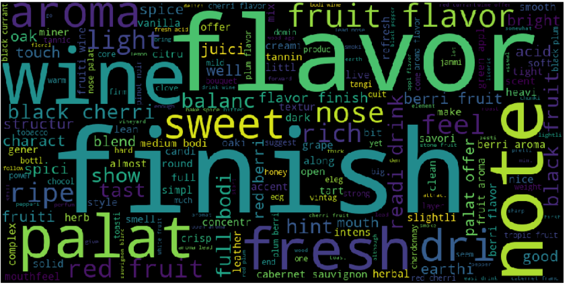
<90 Word cloud
Finish, flavor,Note, Sweet, Palat,Fresh

Slide 11
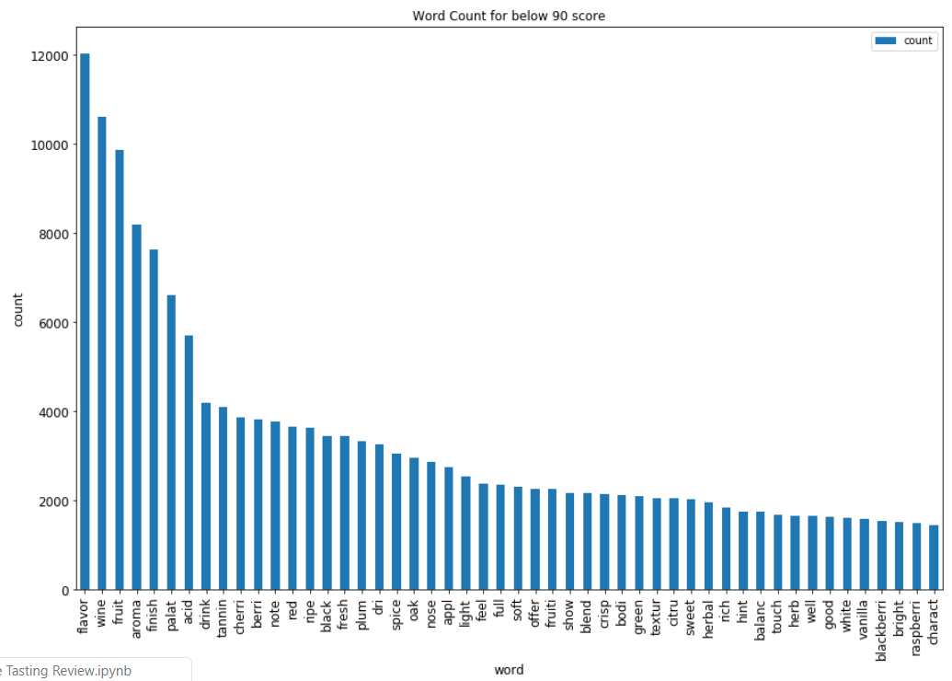
Top 50 words for <90 scord wine

Slide 12
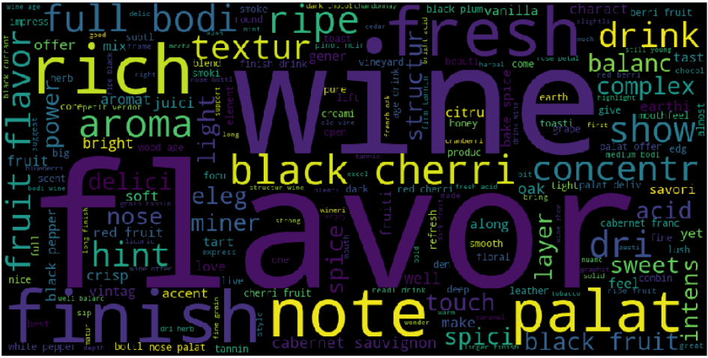
>90 word cloud
Full bodi, rich, textur,

Slide 13
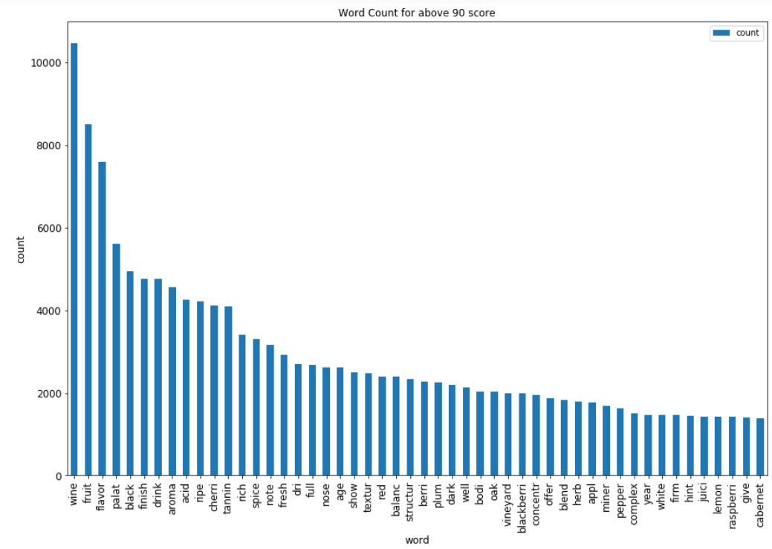
Top 50 words for >90 scord wine

Slide 14
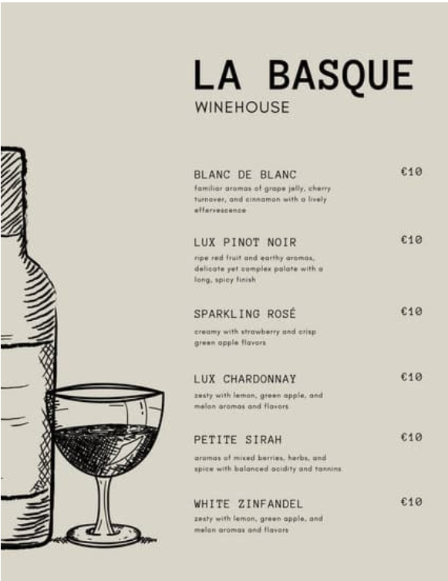
4. Pick-your-wine map
Wine Recommendation in Diner
Regular Wine menu (right) with wine name and description
Pick wine by description

Slide 15
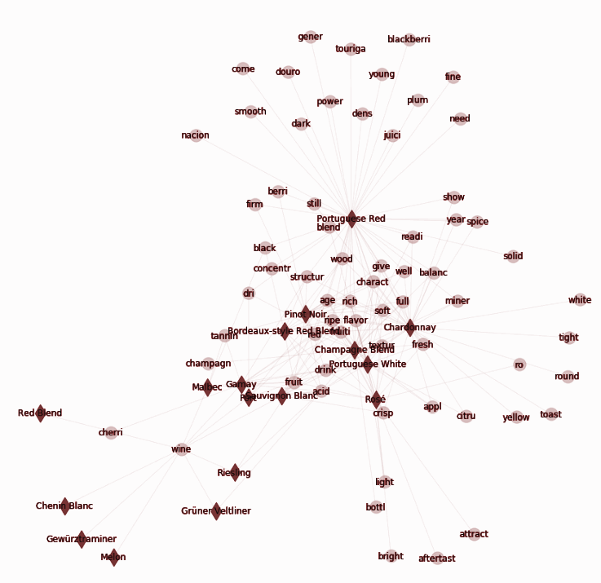
4. Pick-your-wine map
Wine Recommendation in Diner (Cont)
Reviewer-'Roger Voss': common words on each variety - pick your wine by similarity
Chardonnay & Champagne
Rosé & Portuguese Red Blend

Slide 16
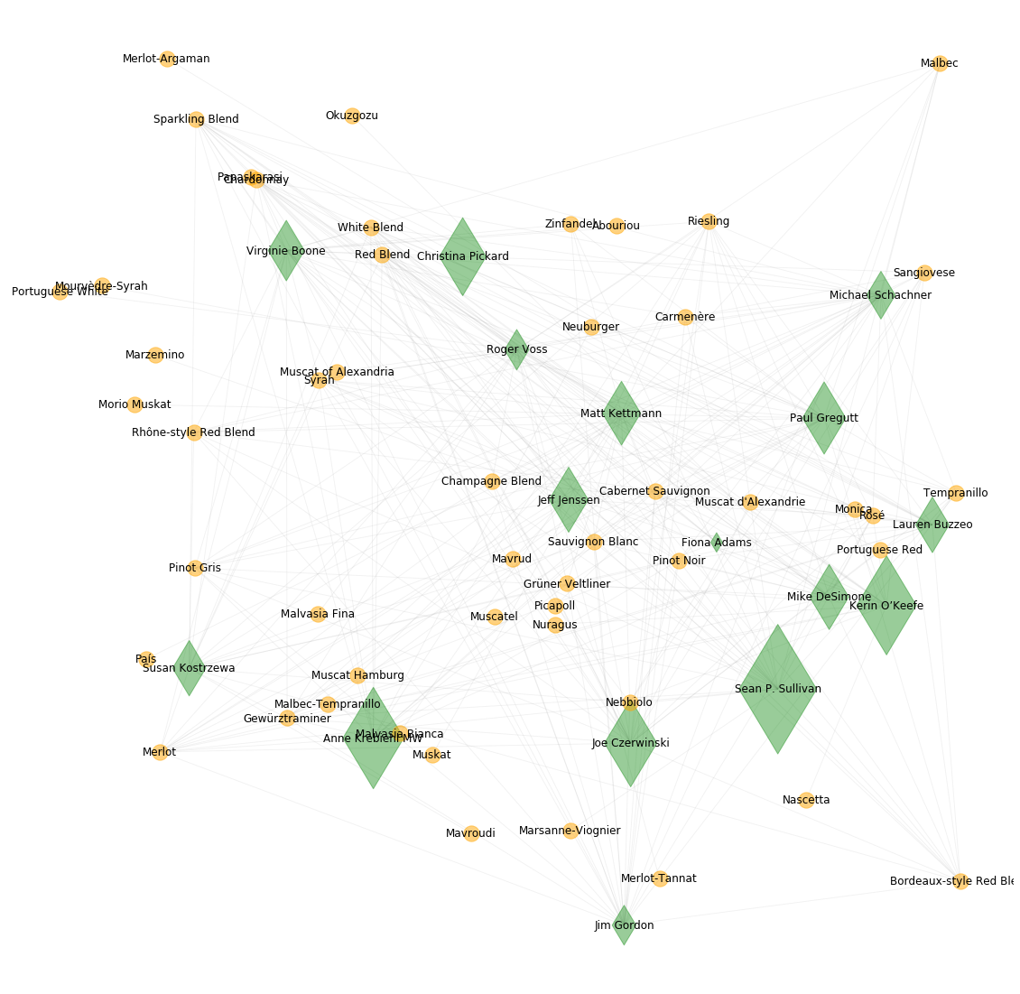
5. Top Wine Social Media Influencers
Most and Least 25 reviewed wines
Bigger diamond = more Twitter followers
Most reviewed x Twit Follwr. = Popular
Least reviewed x Twit Follwr. = Set the tone by Taster

Slide 17
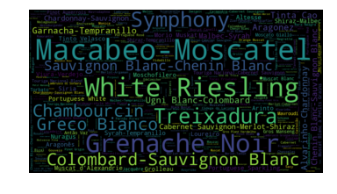
6. Best Value Wine
Best Value = Sentiments Per Price * 100
Variety | Value | Price
Macabeo-Moscatel | 8.870000 | $8.0
White Riesling | 7.923516 | $16.5
Grenache Noir | 7.781111 | $9.0
Treixadura | 6.442667 | $15.0
Symphony | 6.350000 | $12.0

Slide 18
Any Questions?
Sentiment Analysis for Wine reviews
Wine Vocab 101
Pick-your-wine map - Wine Recommendation in Diner
Top Wine Test influencers
Find the Best Value Wine

Slide 19
End

